Slide 1


Project management system
Project update

Slide 2
Content
PMS Introduction
Create Credentials
Create Credentials – Designation
Employee details
System User
Project Creation
Create project or Edit project
Create Task
Workflow introduction
3. Workflow
Assigned workflow
Edit workflow
Transfer Workflow
Workflow email alert
4. Project wise status and PMS user level view

Slide 3
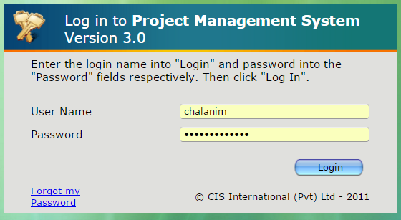
PMS – PROJECT MANAGEMENT SYSTEM
Projects
PMS is designed (tailor-made) for our organization for the purpose of monitoring the performance of each employee even remotely.
Each employee is emphasized and guided on PMS and is expected to fulfill the PMS requirements on time in a regular basis.
Each one - time task assigned for an employee is a Project for him/her. Therefore, PMS should be created with the specific tasks and deadlines for each.
PMs Creation needs to be sent to System Admin Department (since PMS creation is possible only for those who have admin rights in the PMS in System Admin Department). Updating and amendments for the same PMSs should be followed through by the relevant PMS user (it should not be sent for System Admin Department)
PMS
Login to the PMS account
PMS Link - http://69.63.218.233:86/pms/index.php

Slide 4
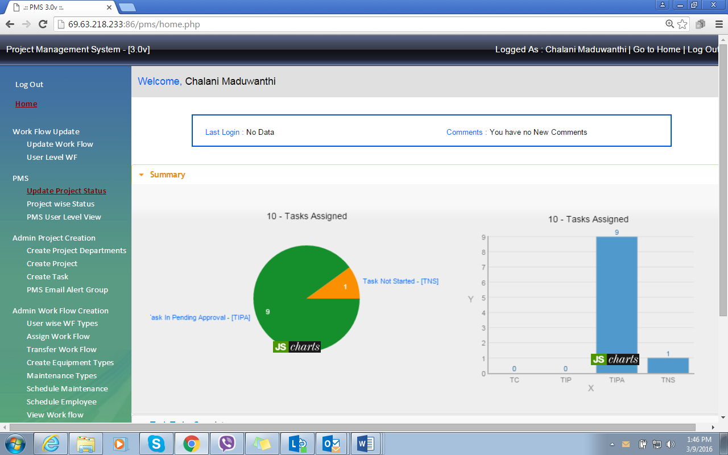
PMS home screen

Slide 5
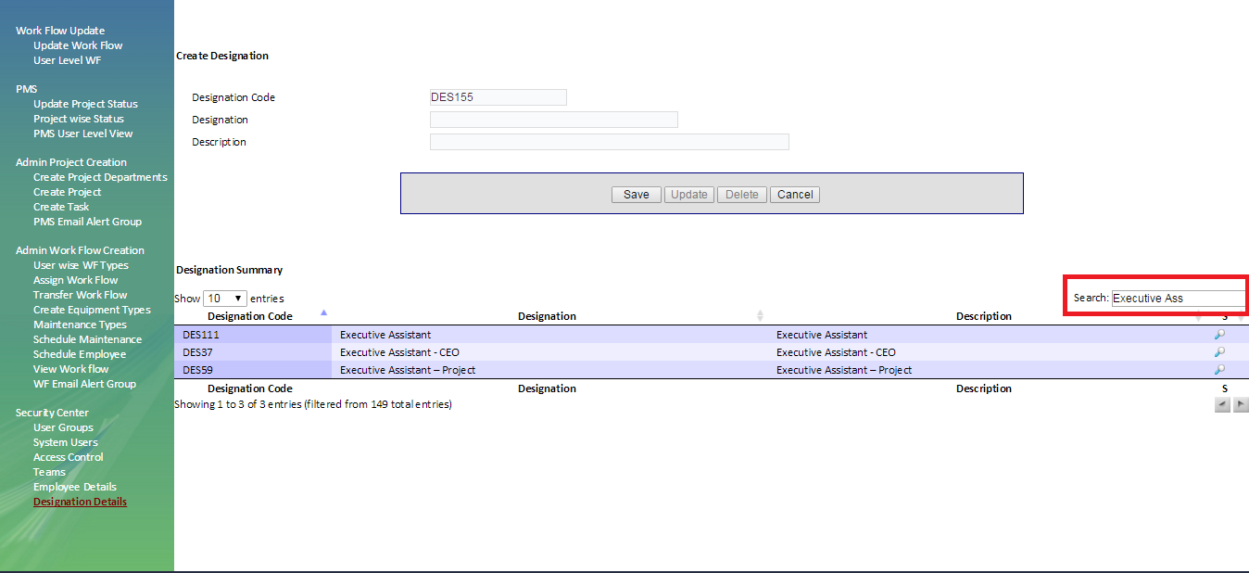
Create Credentials
For New Recruits, HR will raise an IT ticket (service request system) to IT support with access requirement form. Then once you system admin receive that ticket through mail and HOD check and download the access request form from “Specie work” (TEKNOWLEDGE SHARED SERVICE HELPDESK).Based on the form will create PMS credentials and send to employee office email address and update the IT ticketing system as well to confirm the work has done.
Create Credentials – Designation
Check the designation whether that designation already in access or if not need to create a designation in the system.
PMS – Designation Details – Search (type the designation and if the designation is available in the system it will appear)
If the designation is not available in the system need to create a designation

Slide 6
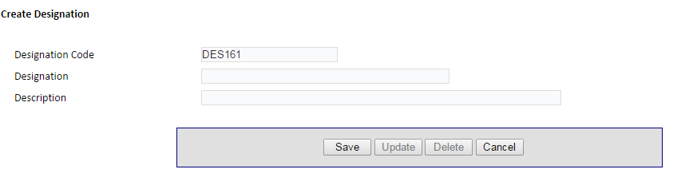
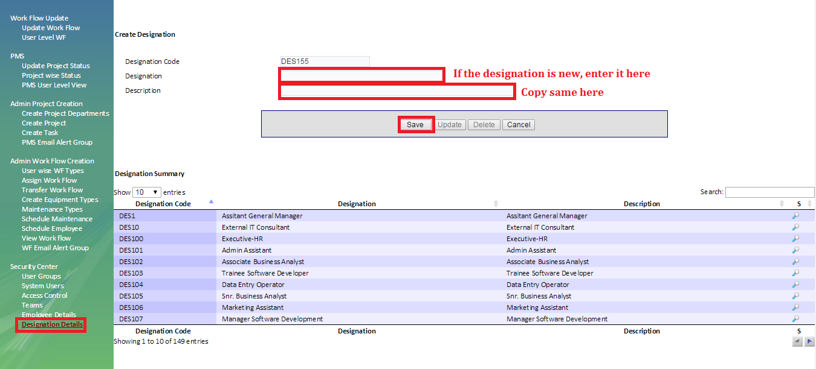
Type the designation that need to be added and “save”.
If we need to change the designation search and select the designation and click and once you done the changes click “update”

Slide 7
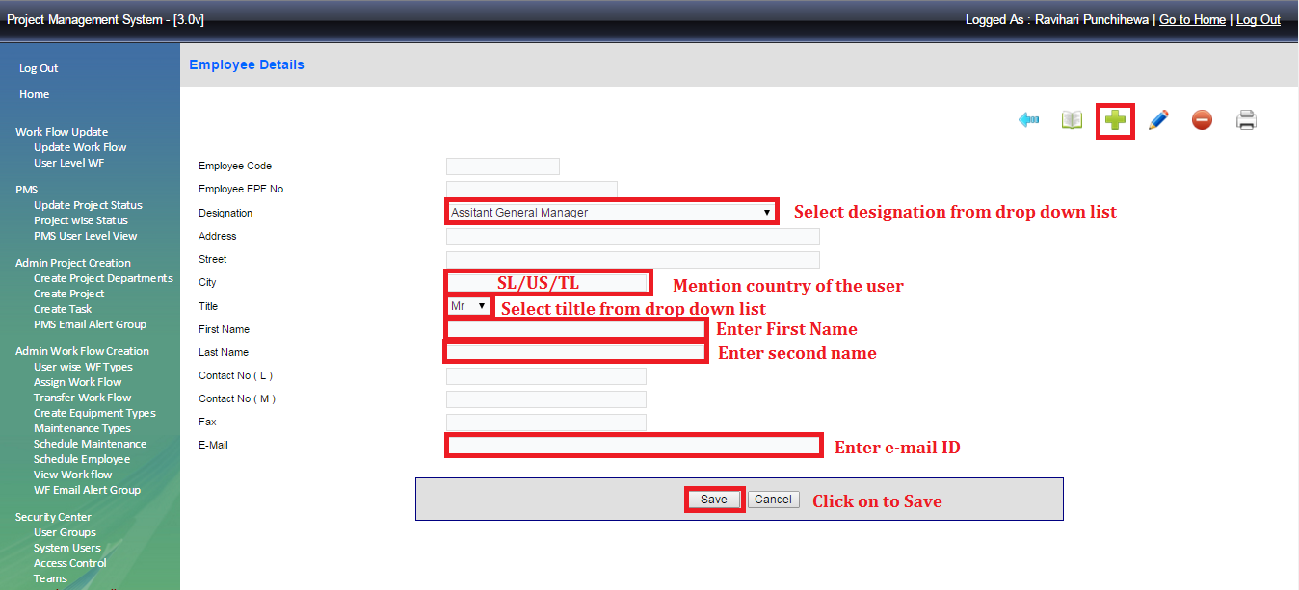
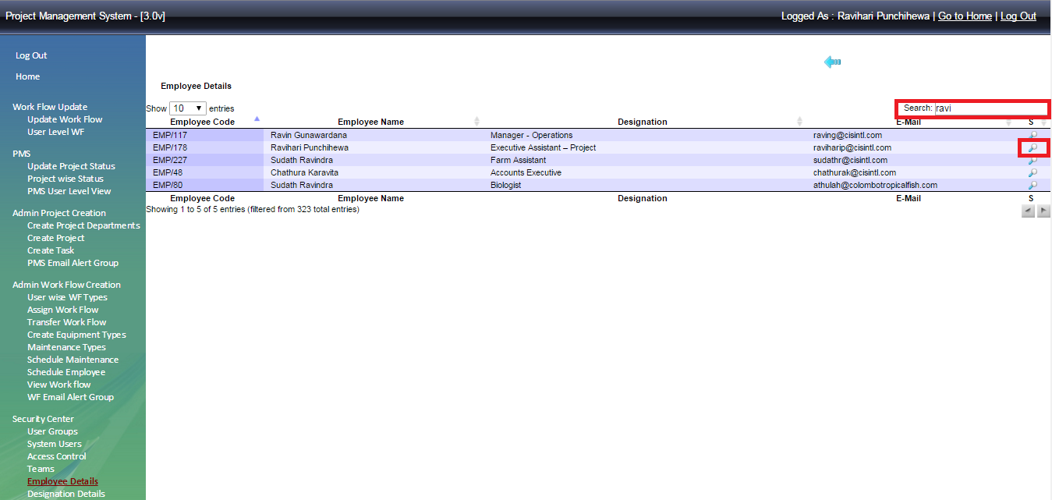
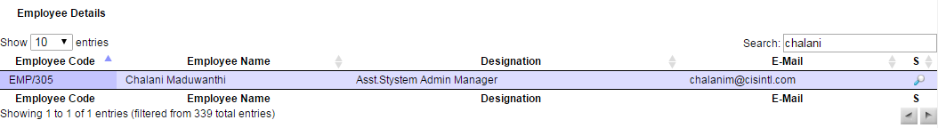
2. Employee details –
Add a new employee
once you have done the designation need to enter employee details to the system to add the employee, click on symbol to refresh the page and enter details as below,
Search designation – Type the country as system mentioned ( SL/US/UK/MLD/TL) – title – first name – Last name – email address – click “save” . Please note highlighted areas are compulsory to fill.
Edit Existing Employee
Click the symbol then search the employee and click which is place before the name.

Slide 8
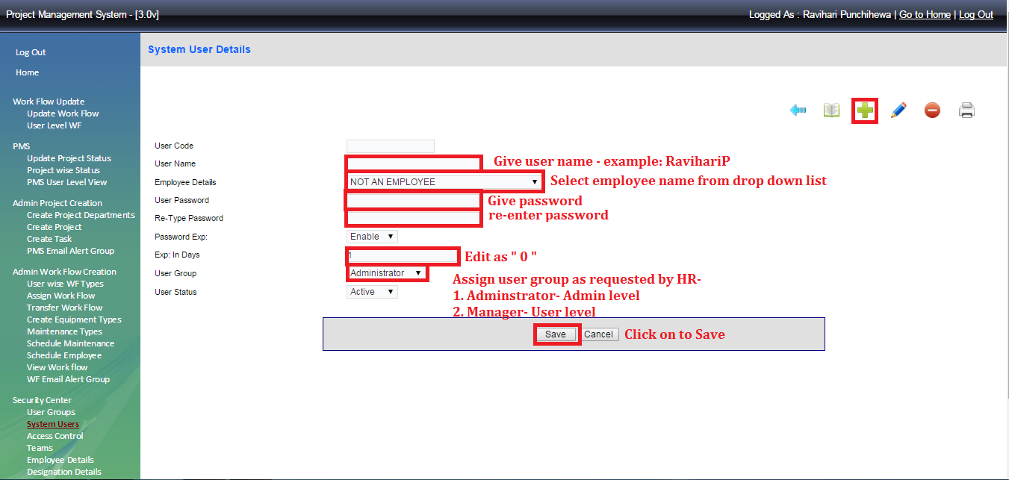
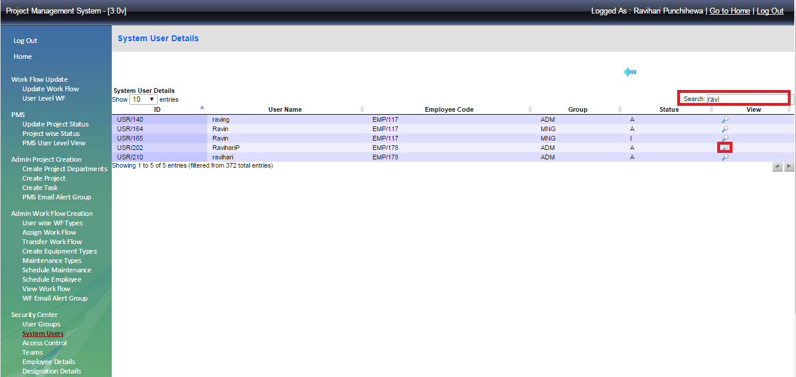
System User –
Create Access for new employee
Creating an access account as requested in the access requesting form ( User / Admin) to the new employee. Refresh the page by clicking and add details as below,
User Name ( Ex. Chalanim) – employee details search from the drop down list - set the pass work and re type it – set Expr in days as “0” ( Zero) – User level as requested (select Manage for User level access and Administrator for Admin access)
Edit Access in existing employee
Search current user type existing user name – click in front of the name.
- type existing user nae – click

Slide 9
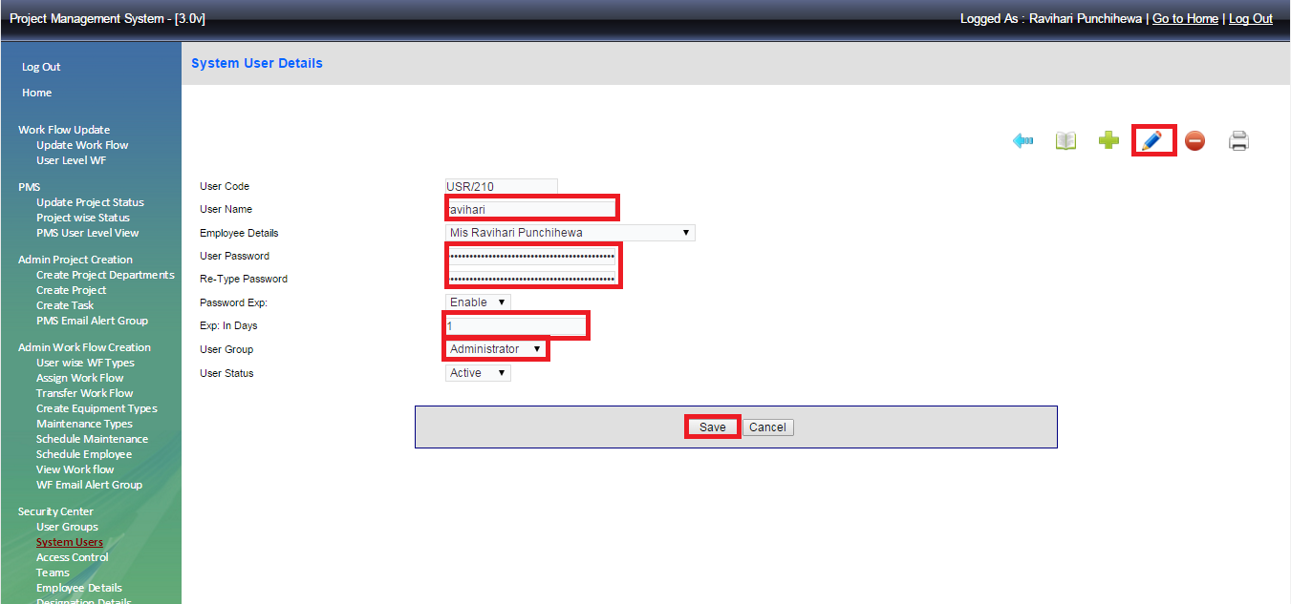
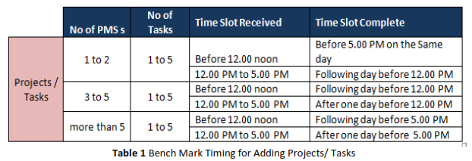
Click to edit user name or password
Re type the user name and password – make “0” Zero Expr days – select user group as administrator or manager – “Save”
Project Creation
Bench mark times for PMS creations with more than 5 tasks will have to be handled case by case. Soon after a new PMS is added / existing PMS is updated/ extended, screenshots will be sent via email to relevant person who re3quested the requirement to confirm the request is done.
Once3 a PMS is created for an employee, any changes, updates or extensions required should be sent to System admin Department. Through the relevant HOD without the relevant HOD’s approval, none will be performed. The same requirement in respect of HODs will be performed ONLY with the approval from CEO.

Slide 10
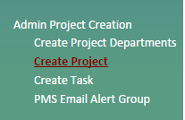
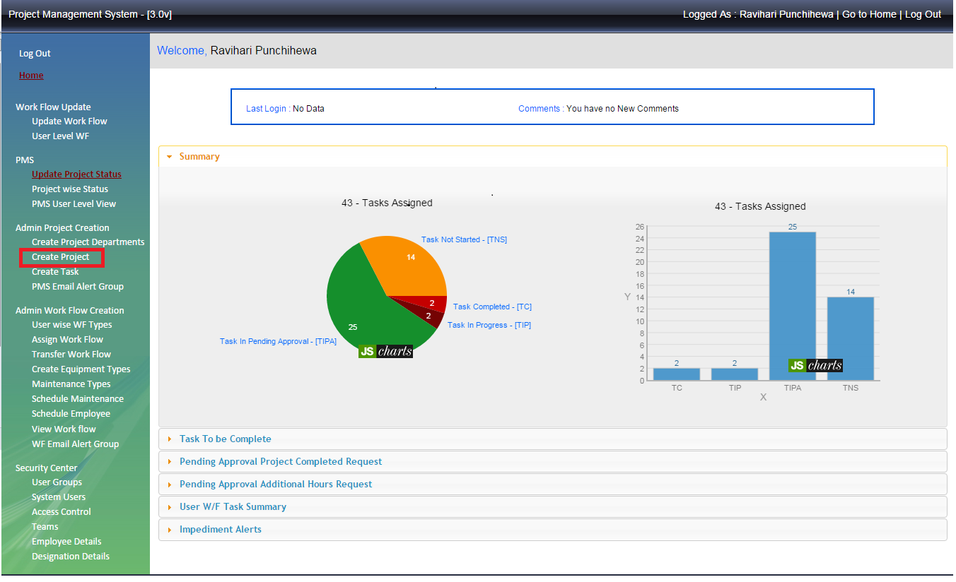
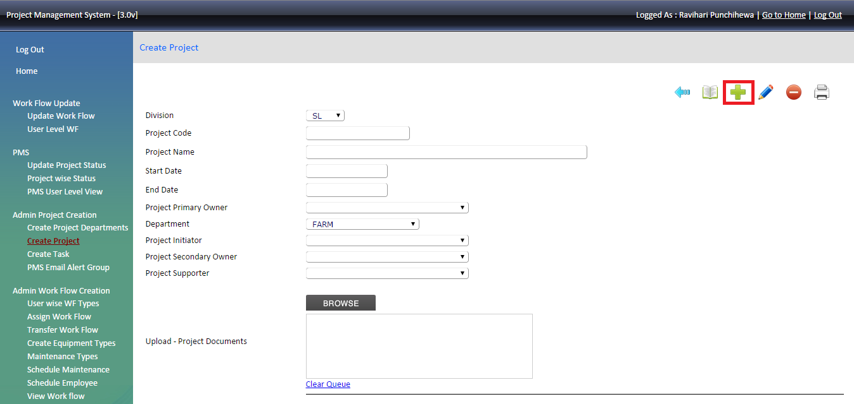
2.1 Create project or Edit project
Select “Create Project” to add new project or to edit project details.
To add a new project click symbol and fill the requested details.

Slide 11
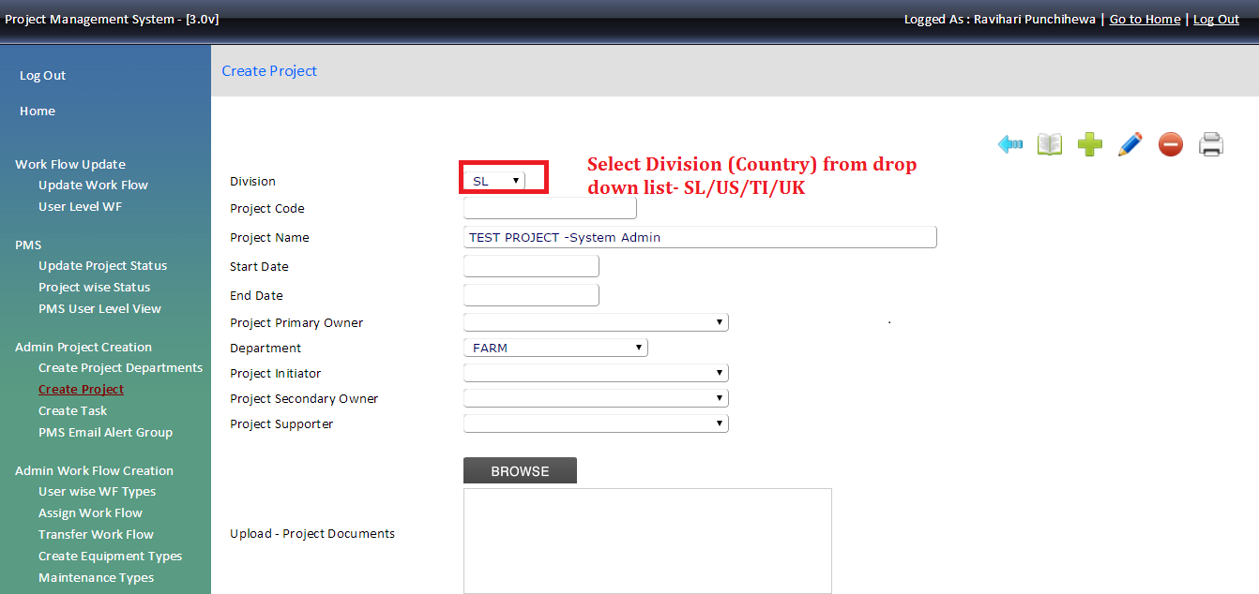
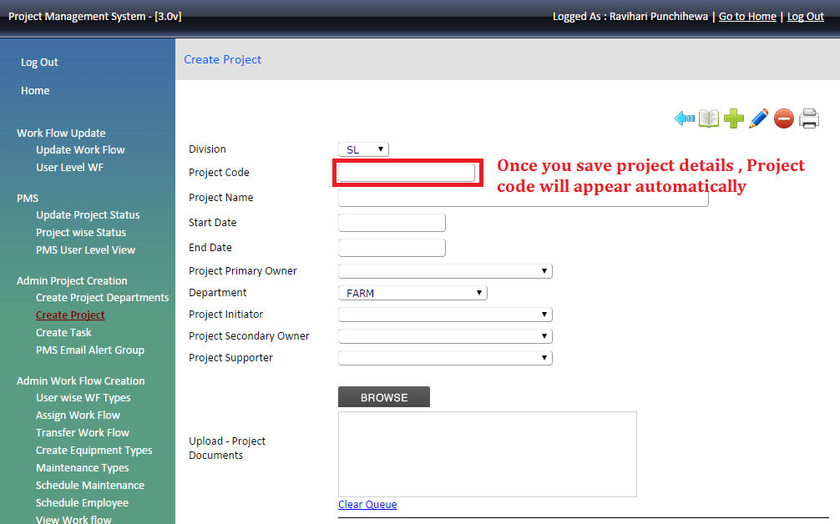
Division
Project code – once we save the project details, project code will generate automatically.

Slide 12
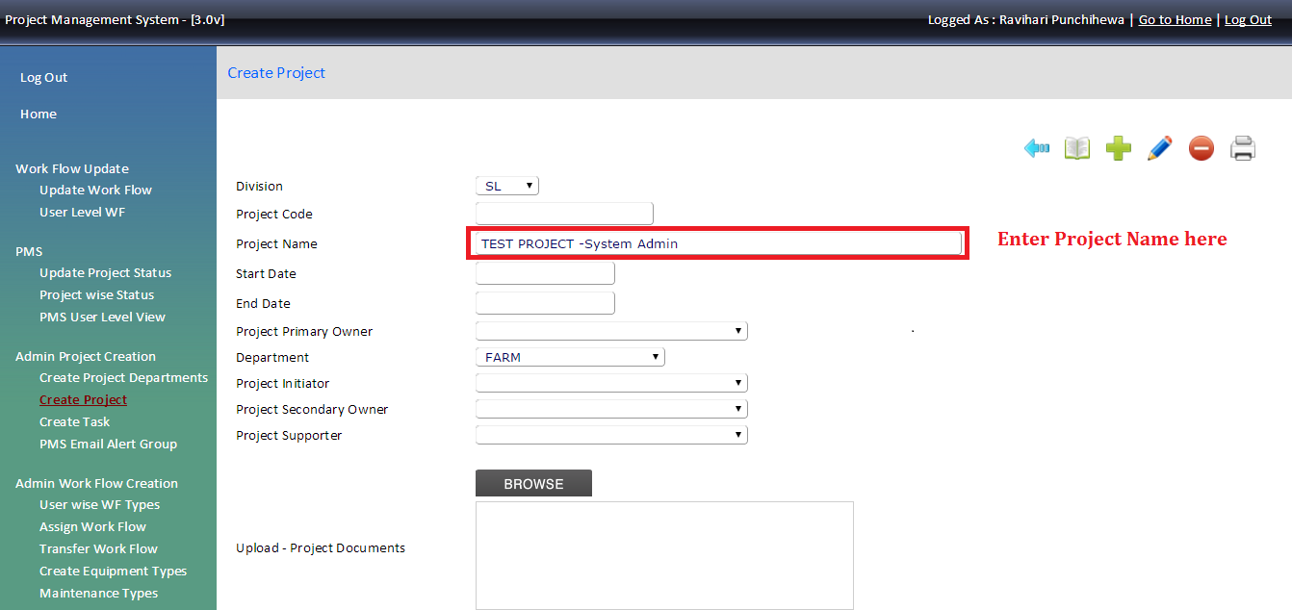
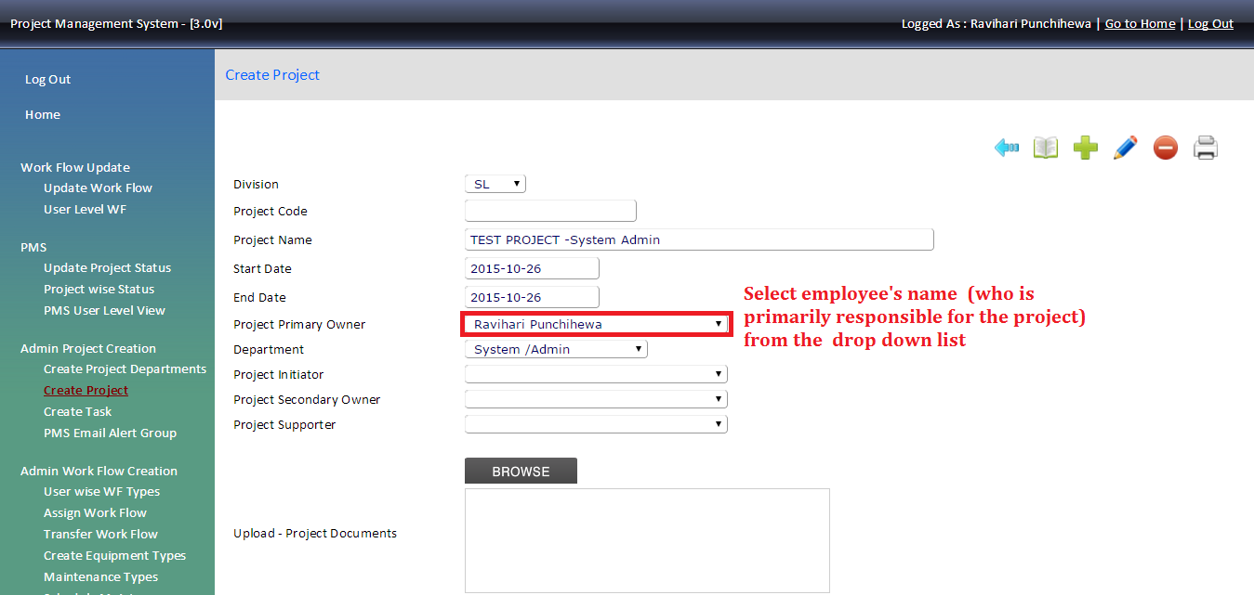
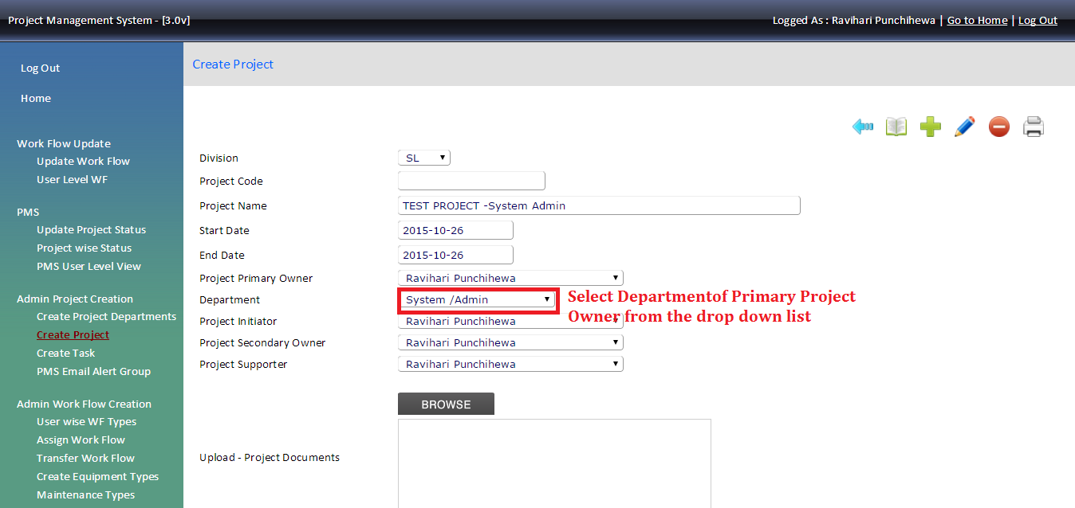
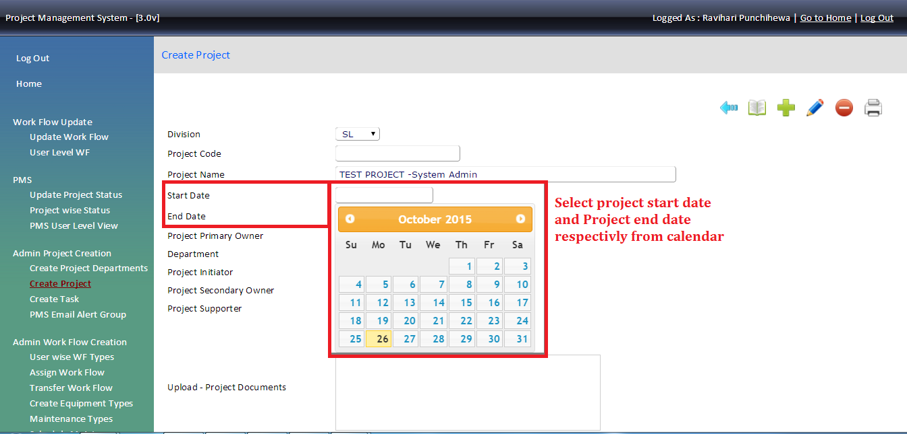
Project
Project Primary owner
select the department
Start date & End date

Slide 13
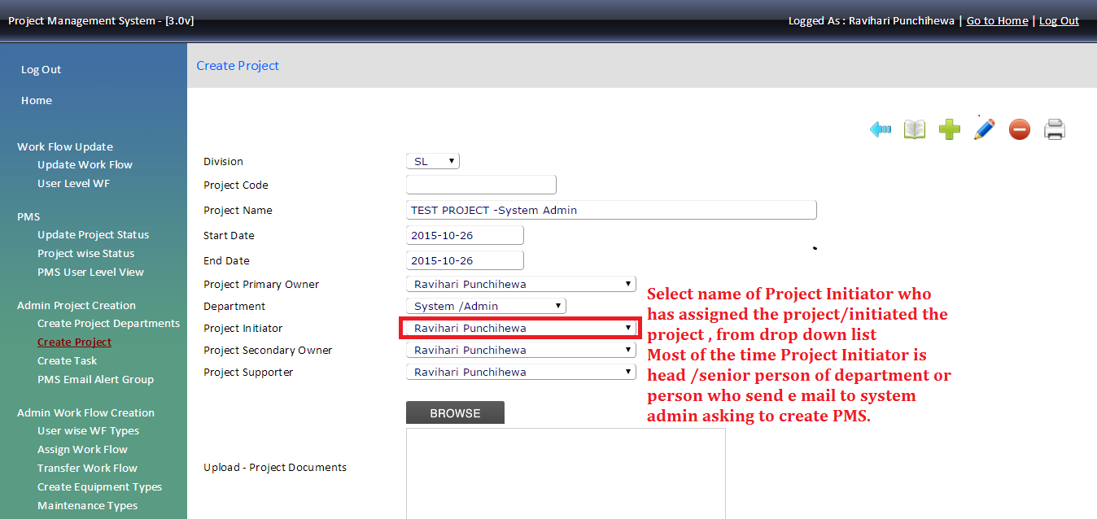
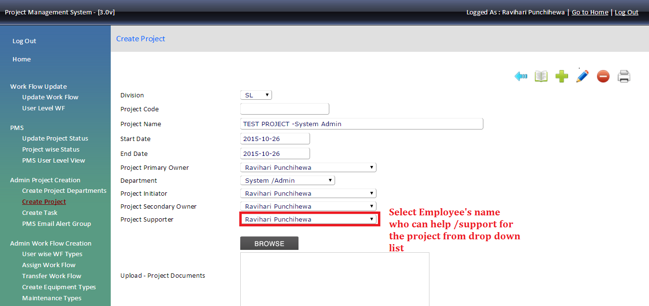
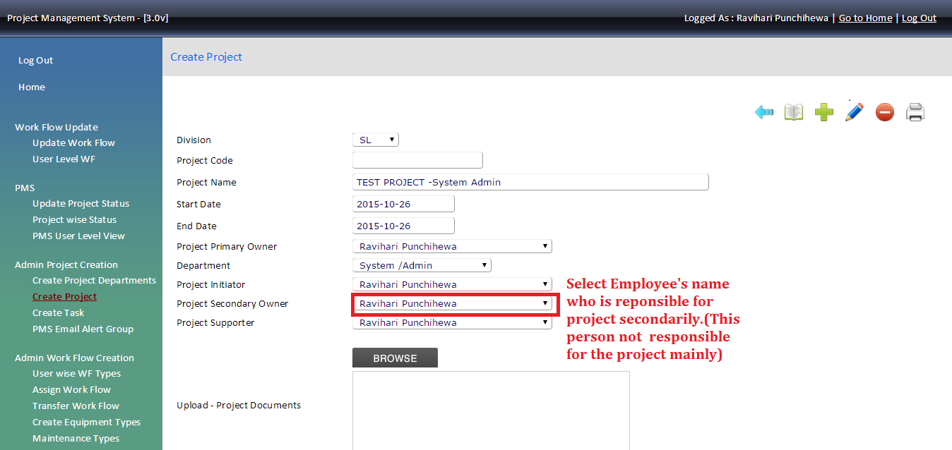
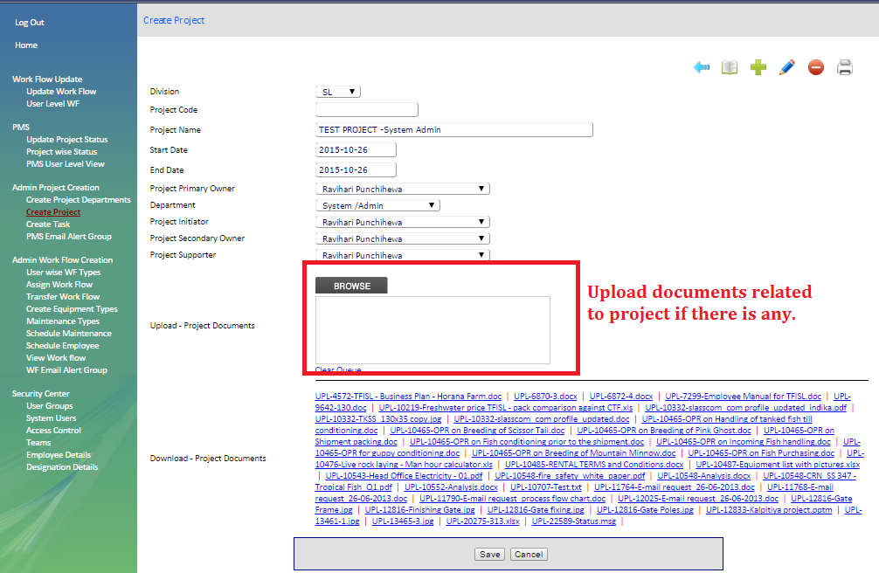
Project initiator
Project supporter ( if applicable otherwise select” none”)
Project secondary owner (if applicable otherwise select “none”)
Browse the document if you need to attached any document to the project

Slide 14
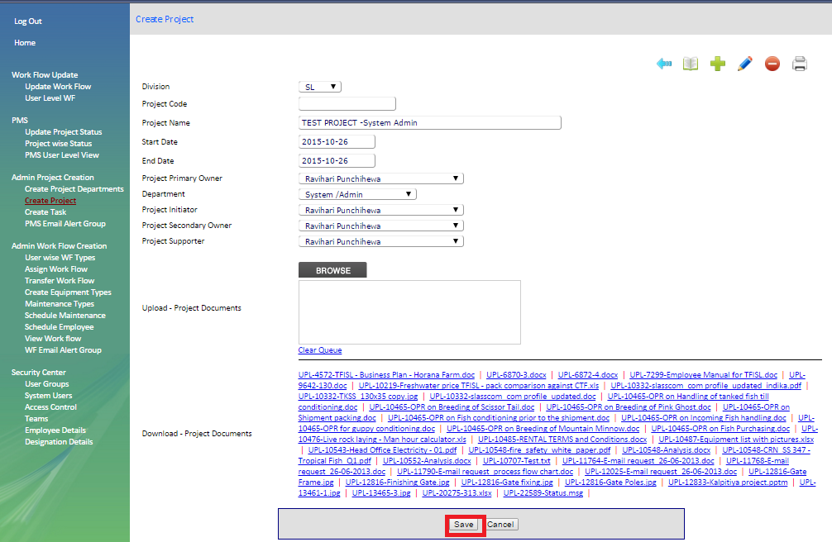
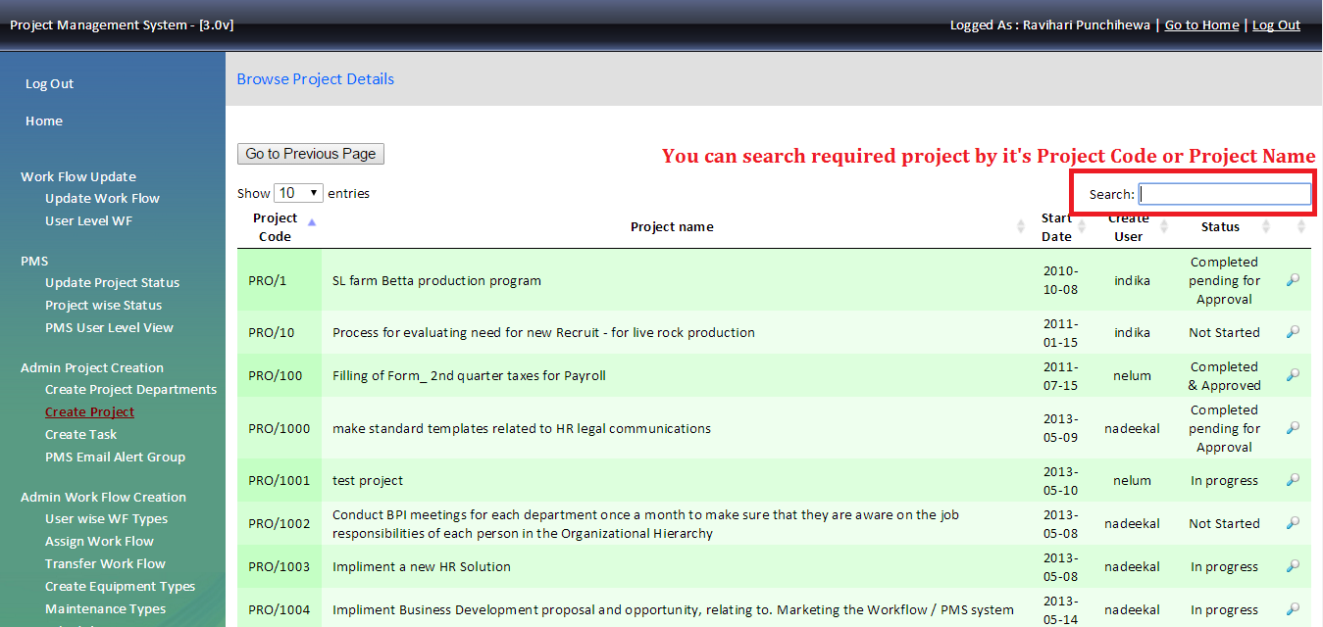
Click “Save” to save the create project in the system.
Edit Project
To edit existing project click symbol in create project page and search the project given by name or by project code.

Slide 15
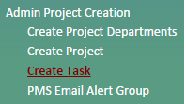
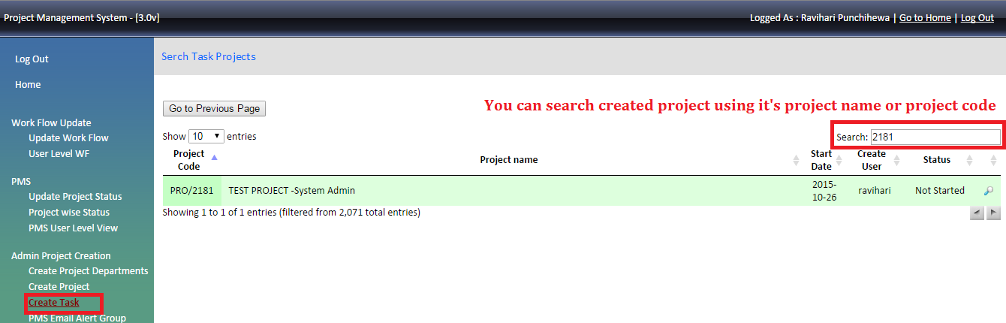
Once you found the project that you need to edit click in front of the project name then for edit. Once the screen appear edit details ( as we create a project ) and “ Save”
2.2 Create Task
Create project tasks under created project. If we don’t have the task and only the project we need to take the same topic of the project and create a task under that project without not creating a task (to create a task under project is compulsory).
Note: - Necessary to create at least one task for each project otherwise user cannot see the any of assigned project in their home page.
Search project by name or by project code then click the in front of the name.

Slide 16
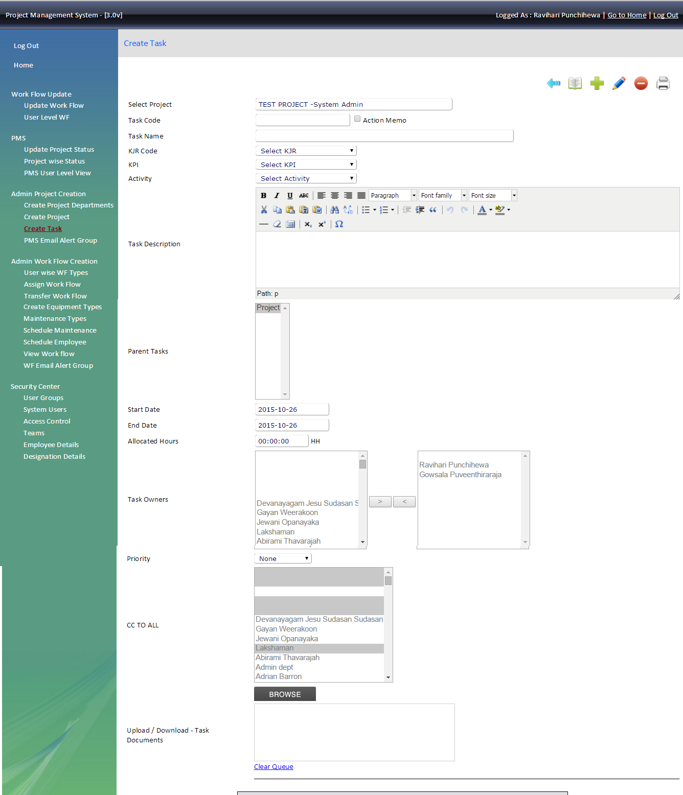
Create

Slide 17
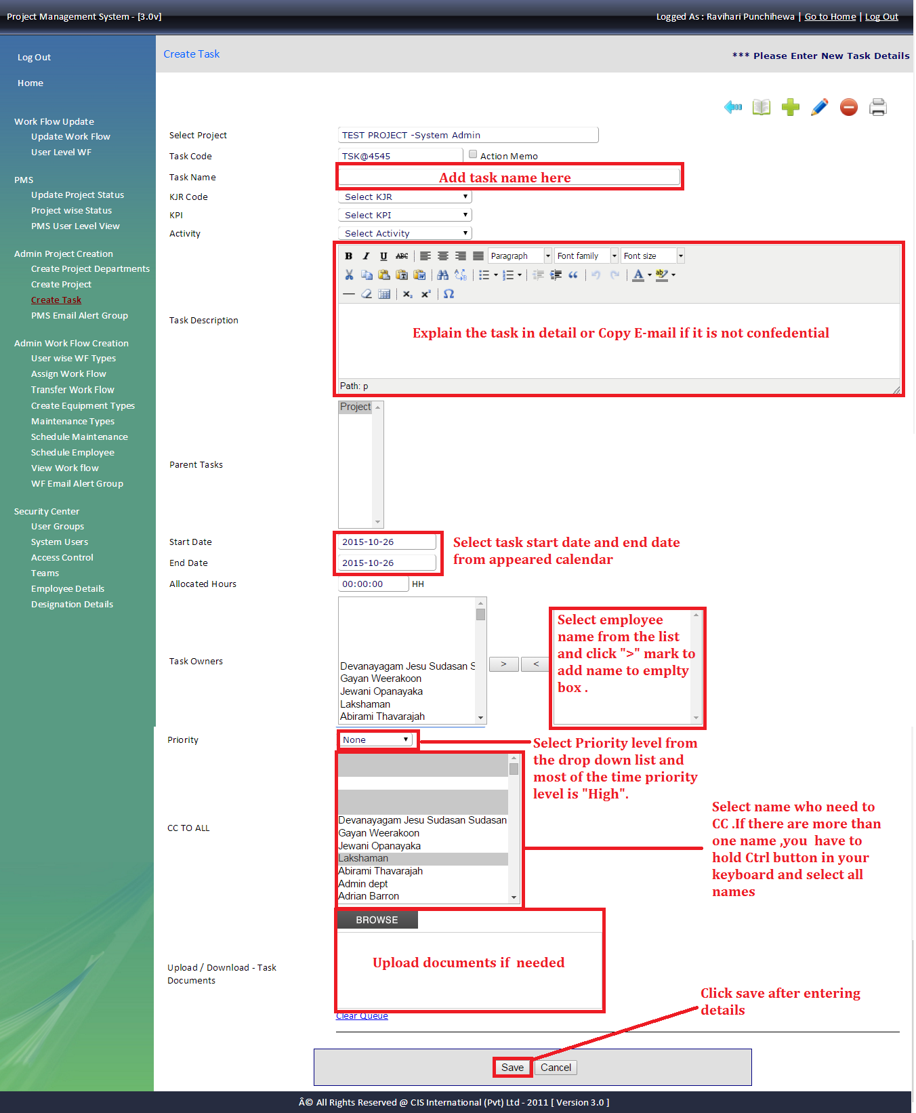
Click the to refresh the page and add details as follows
To add more task to the same project add by clicking and enter tasks
To edit tasks details select the task from parent’s task and click to edit or change details.
To delete the task , select the task from parent’s task and click and save changes.
Once created the project send email with the attached created screen shot of the project

Slide 18
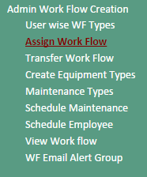
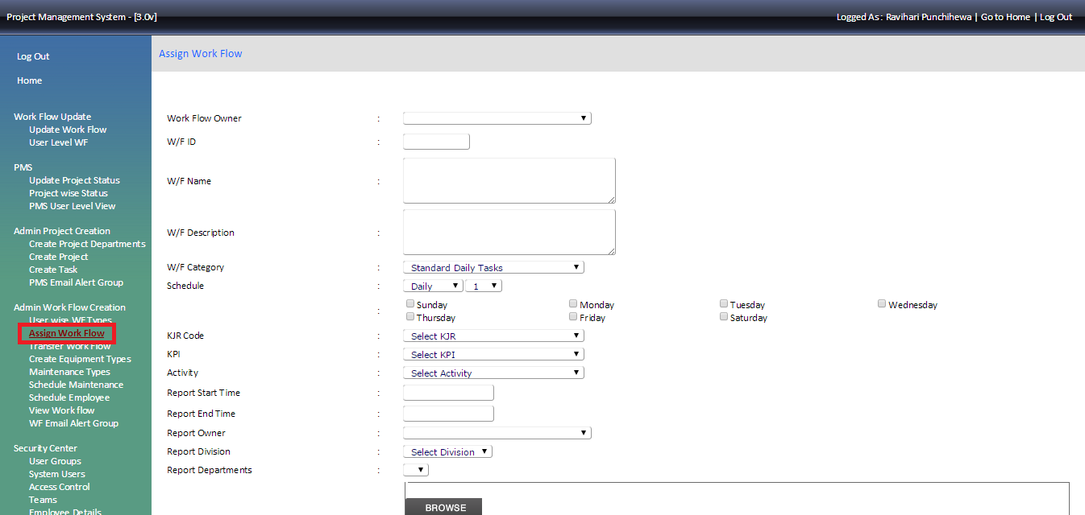
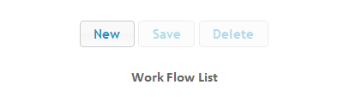
Workflow
3. Workflow
Workflow is a collection of tasks that each employee performs on daily basis. HOD of each department is responsible for issuing workflows for their staff members. In general workflows are available only from Monday to Friday (if not exceptional). Each day is covered with list of task to be performed during the day with an allocated time slot. Collection of allocated time slots for each day should be a total of 8 hours or more.
Workflow tasks could be repetitive for two or more days. Also there are tasks daily as well as only for specific days. End of each day, employee should refer his /her workflow and update it accordingly.
Summary of all updates / dues are sent via email to relevant staff member, System Admin Department and the relevant HOD.
3.1. Assigned workflow
This tool is to create or edit workflow of the employee.
Select the name in the work flow owner and select New at the bottom to refresh the page.

Slide 19
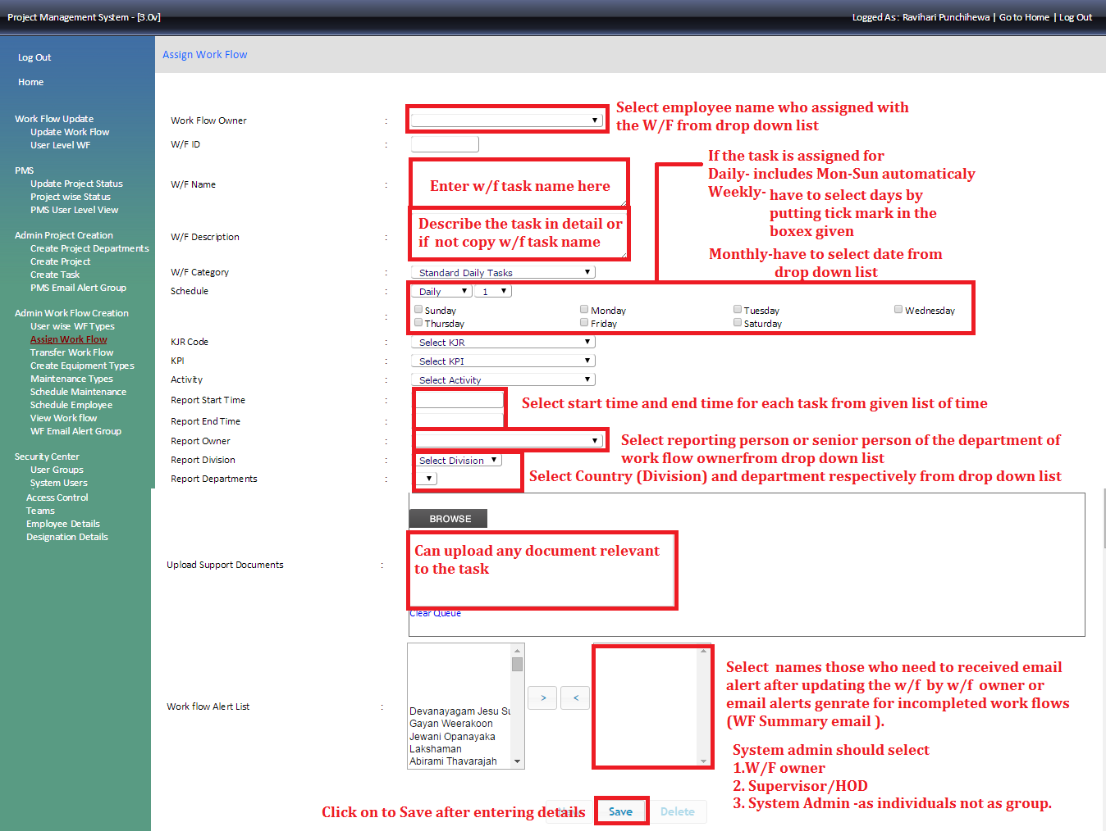
Enter details as mentioned as follows

Slide 20
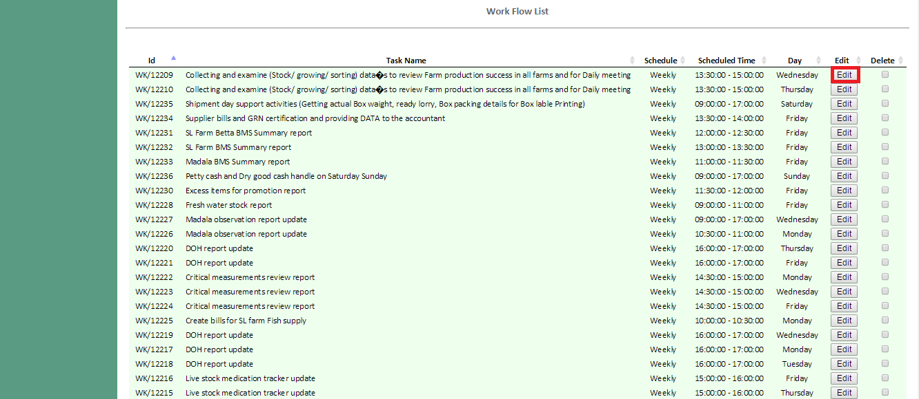
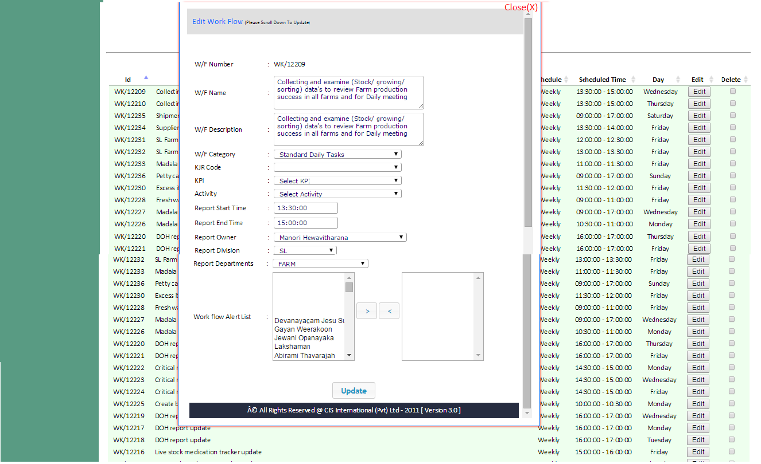
3.2 Edit workflow
To edit workflow task – go to task list and select the task and click edit
Then once the following screen will appear and then update details and click update button to save edit details
Please note need to change each task that you need to edit as above.
If one workflow task is for five days (Mon to Fri) you need edit each task (5 tasks for 5 days) and edit the same way.

Slide 21
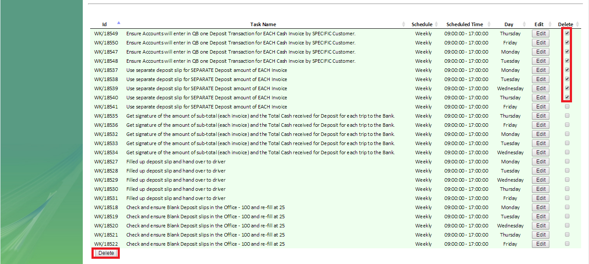
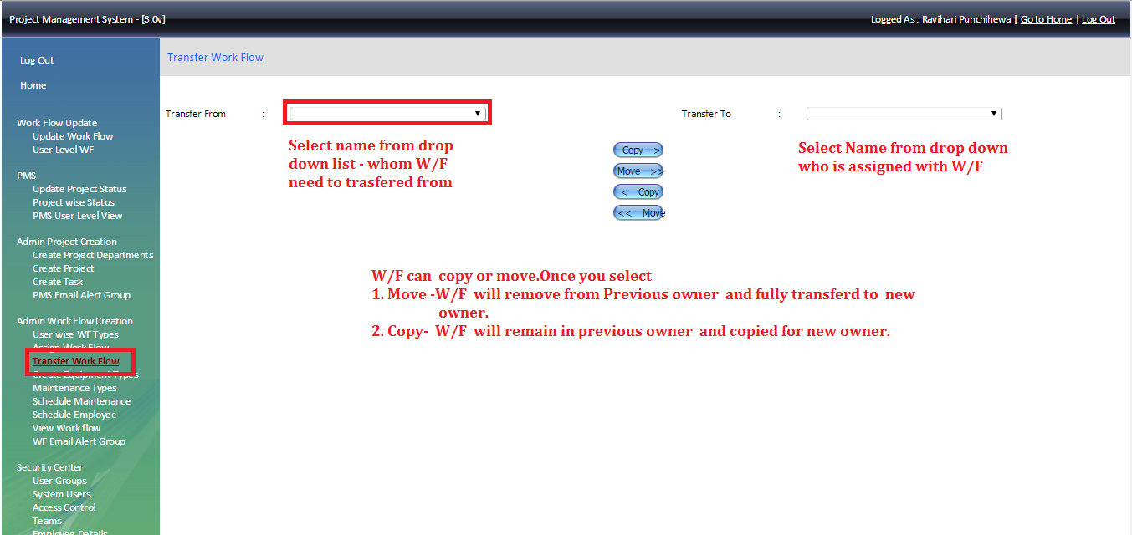
To delete task from Work Flow you have to put “” on to the tick box and click on to delete button.
3.3 Transfer Workflow
Go to the transfer workflow section and follow the mentioned instructions as in the screen shot

Slide 22
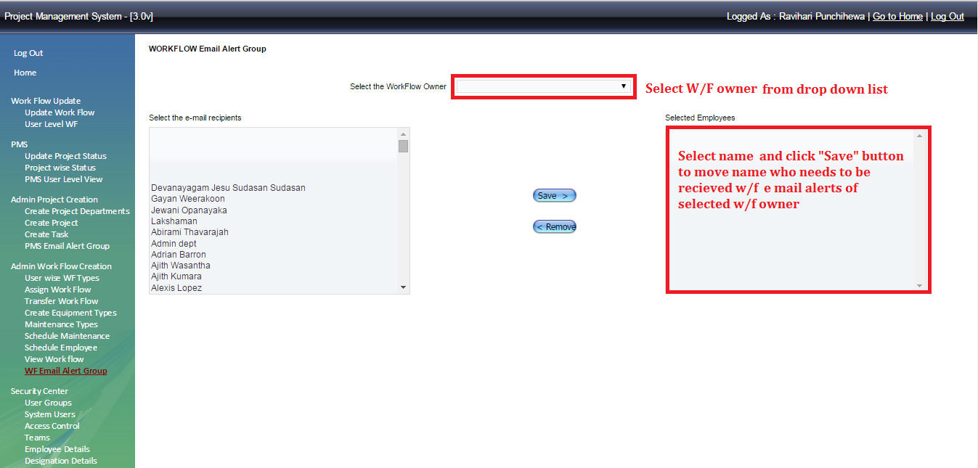
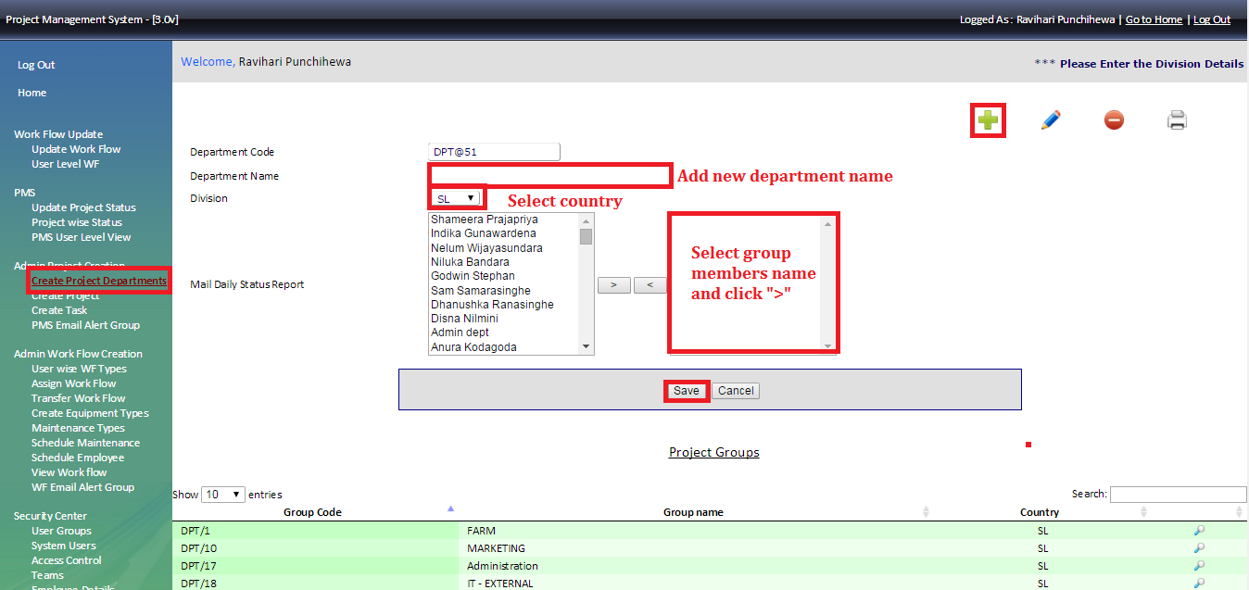
4 Workflow email alert
If there is requirement for any senior person to received work flow after entering it to the system, you can use this section to add those recipients.
To get the workflow summary – Create project department and select the department then add the head of the department (who wants to have the department summary) with system admin

Slide 23
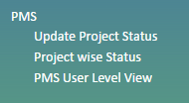
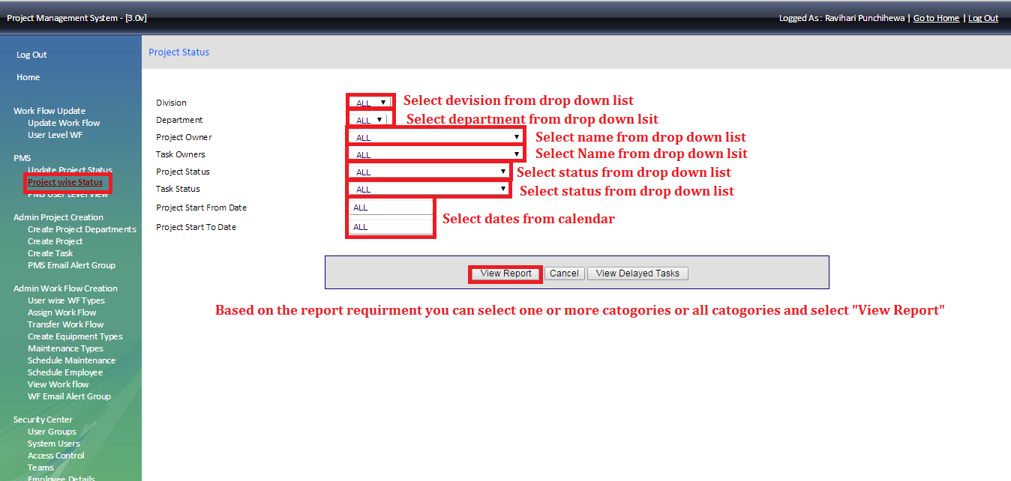
Project wise status and PMS user level view
Primary responsibility of System Admin is to follow up and conduct PMS review meetings for each department.
Using “Project Wise Status “section system admin can have a report in various categories as below
All projects
SL projects/US Projects
SL department wise projects /US department wise projects
Project owner wise report
Task owner wise report
Projects in specific time period

Slide 24
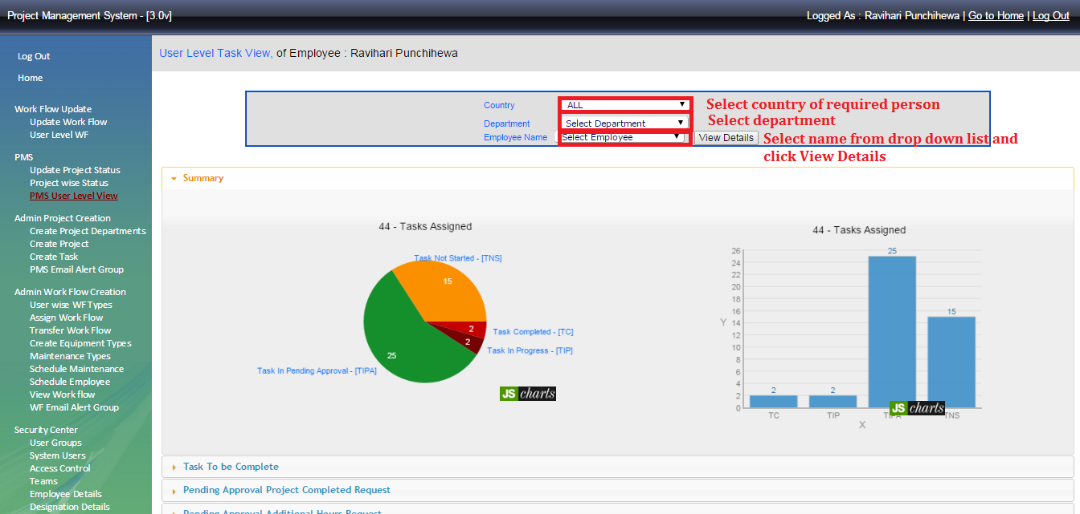
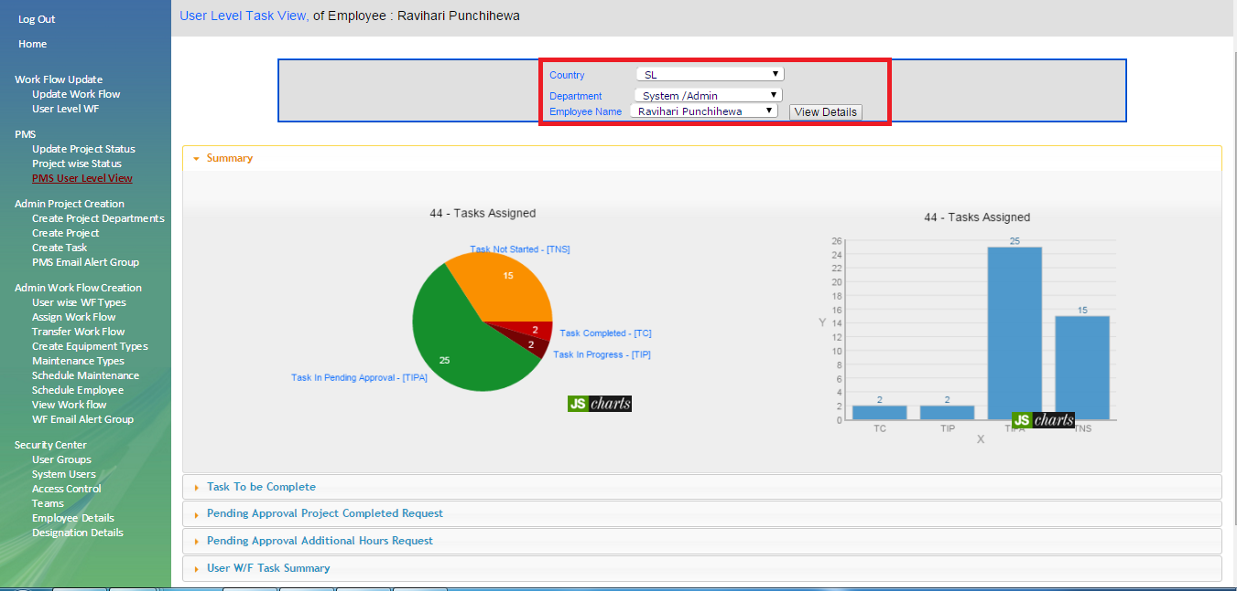
Also system admin can have user wise report using “PMS user level view”
Pie chart gives overall idea about projects assigned to selected employee.

Slide 25
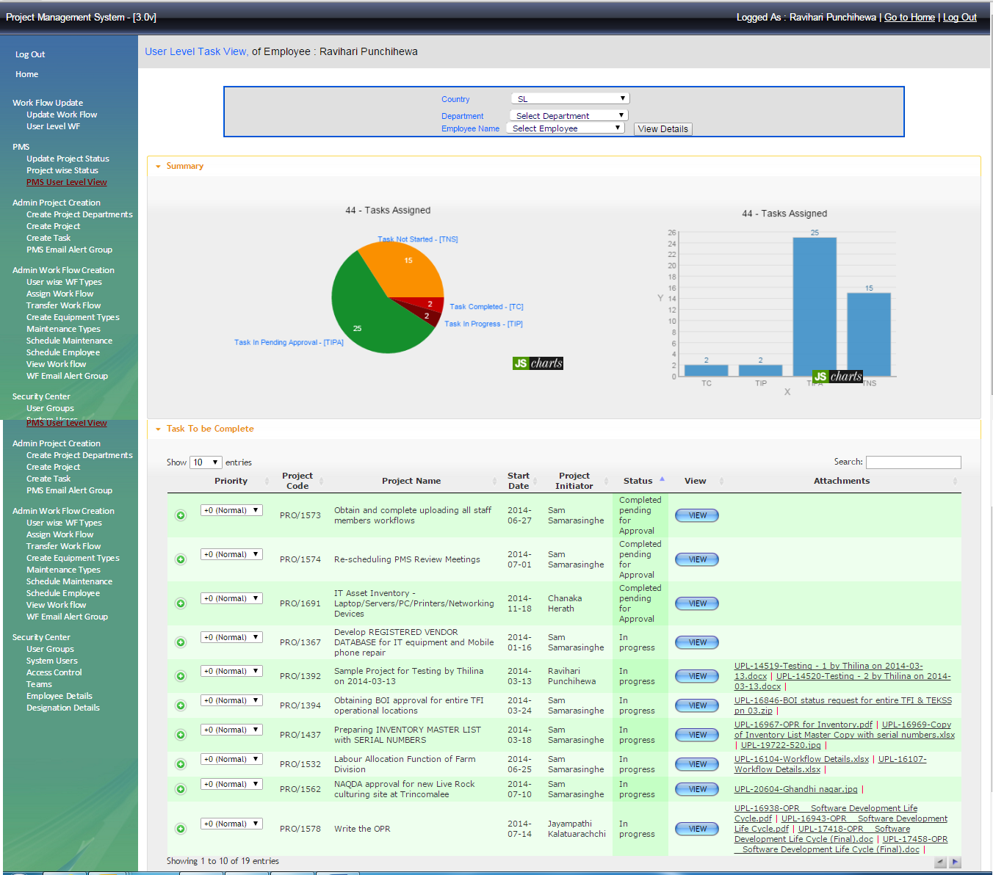
To view more details, click on to “to be complete” as below screen shot.

Slide 26
Thank you !

